Slide 1
Git and GitHub
Mohammad Ashraful Huq

Slide 2
Agenda
Version Control-What & why?
Version Control Tools
Git & GitHub
Git Features
Git Operations & Commands

Slide 3
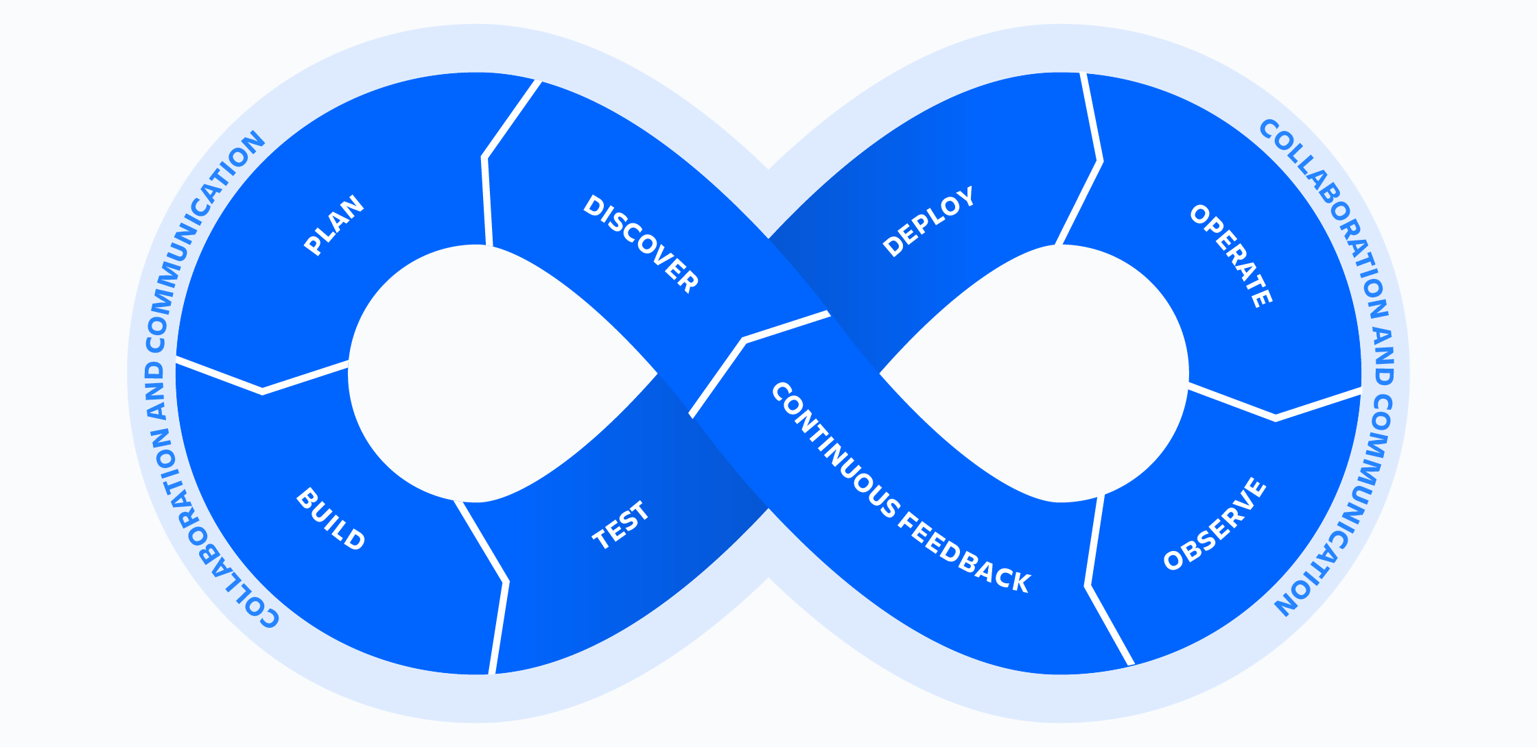
DevOps (Development and Operations)

Slide 4
Git and GitHub
What is Version Control?
Version control, also known as source control, is a system that records changes to a file or set of files over time so that you can recall specific versions later.
So ideally, we can place any file in the computer on version control.
The reason:
A Version Control System (VCS) allows you to revert files back to a previous state, revert the entire project back to a previous state, review changes made over time, see who last modified something that might be causing a problem, who introduced an issue and when, and more.

Slide 5
Git and GitHub
Version control systems are software tools that help software teams manage changes to source code over time.
As development environments have accelerated, version control systems help software teams work faster and smarter.
Version control software keeps track of every modification to the code in a special kind of database. If a mistake is made, developers can turn back the clock and compare earlier versions of the code to help fix the mistake while minimizing disruption to all team members.

Slide 6
Git and GitHub
Using a VCS means that if something goes wrong, like you lose files, for example, you can generally recover easily.
Many people’s version-control method of choice is to copy files into another directory (perhaps a time-stamped directory, if they’re clever), it is also incredibly error prone.
Software teams that do not use any form of version control often run into problems like not knowing which changes that have been made are available to users or the creation of incompatible changes between two unrelated pieces of work that must then be painstakingly untangled and reworked.

Slide 7
Advantages of VCS:
Enforce discipline;
Archive version;
Recover from accidental deletions or edits;
Enable collaboration;
Maintain historical information;
Conserve disk space.

Slide 8
Git and GitHub
VCS Types-
Centralized Control System and
Distributed Control System

Slide 9
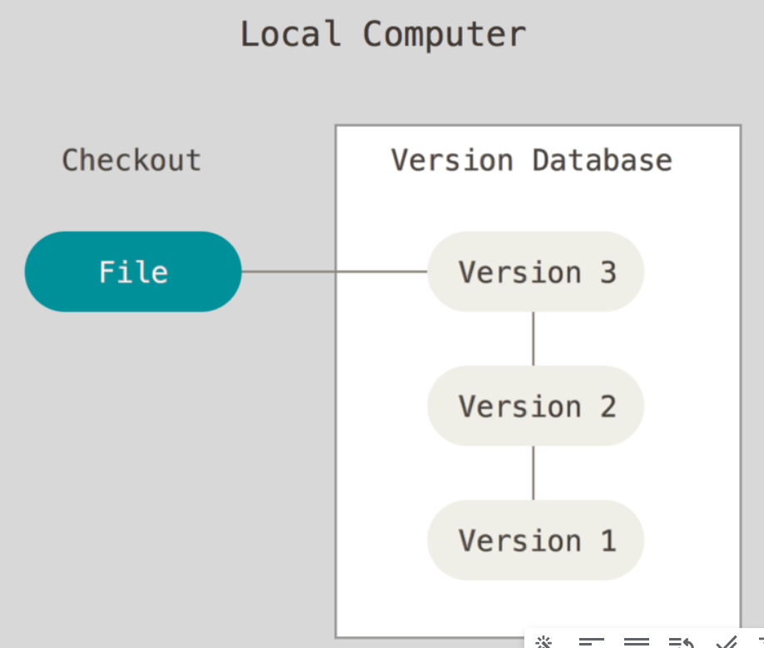
Local Version Control Systems
It is easy to forget which directory you’re in and accidentally write to the wrong file or copy over files you don’t mean to.
To deal with this issue, programmers long ago developed local VCSs that had a simple database that kept all the changes to files under revision control.
RCS (Revision Control System)-One of the most popular VCS tools , which is still distributed with many computers today.

Slide 10
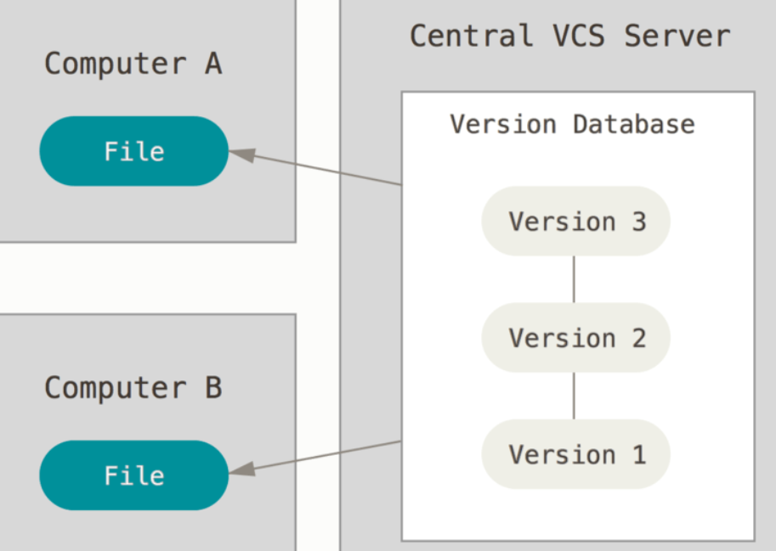
Centralized Version Control Systems
The next major issue that people encounter is that they need to collaborate with developers on other systems. To deal with this problem, Centralized Version Control Systems (CVCSs) were developed.
These systems (such as CVS, Subversion, and Perforce) have a single server that contains all the versioned files, and a number of clients that check out files from that central place. For many years, this has been the standard for version control.
The single point of failure that the centralized server represents. If that server goes down, then during that time nobody can collaborate at all or save versioned changes to anything they’re working on.

Slide 11
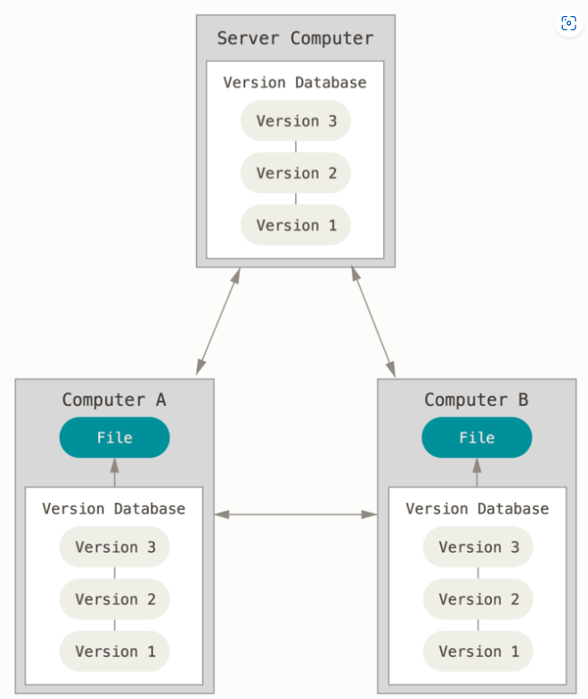
Distributed Version Control Systems
In Distributed Version Control Systems (DVCSs) such as (Git, Mercurial or Darcs), clients don’t just check out the latest snapshot of the files; rather, they fully mirror the repository, including its full history.
Thus, if any server dies, and these systems were collaborating via that server, any of the client repositories can be copied back up to the server to restore it. Every clone is really a full backup of all the data.

Slide 12
DVCSs VS CVCSs -network latency overhead
In a CVCS, many operations involve network communication, and this can introduce delays due to the time it takes to send and receive data over a network. These operations might include checking out code, committing changes, merging branches, and more. In CVCS, network latency overhead can be a common issue, leading to slower interactions with the central server.
When we compare Git to CVCS in this aspect, Git seems remarkably faster because Git is a distributed version control system, and it minimizes the need for frequent network communication.
In Git, most operations are local, meaning they are executed on your local machine without the need for constant interaction with a central server.

Slide 13
Git and GitHub
But What Is GitHub?
Git is a tool. GitHub is the name of the software and the company that uses git (a tool) to give us many valuable services.
There are many git based online platforms / services. For example: GitLab, BitBucket etc.
GitHub is probably the most popular one. So this is what we will explore in this class.

Slide 14
Git and GitHub
What is Git?
Git is a version-control system for tracking changes in computer files and coordinating work on those files among multiple people.
Git is a Distributed Version Control System. Which means Git does not necessarily rely on a central server to store all the versions of a project’s files.

Slide 15
Git and GitHub
Instead, every user “clones” a copy of a repository (a collection of files) and has the full history of the project on their own hard drive.
This clone has all of the metadata of the original while the original itself is stored on a self-hosted server or a third-party hosting service like GitHub.
Git helps you keep track of the changes you make to your code. It is basically the history tab for your code editor.
If at any point while coding you hit a fatal error and don’t know what’s causing it you can always revert back to the stable state.

Slide 16
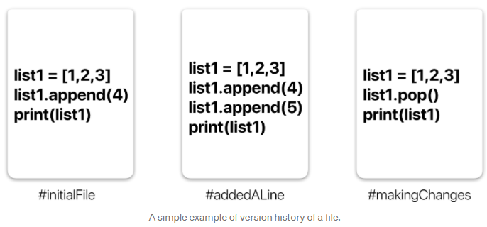
Git and GitHub
So it is very helpful for debugging. Or you can simply see what changes you made to your code over time.

Slide 17
Git and GitHub
In the example in the previous slide, all three cards represent different versions of the same file.
We can select which version of the file we want to use at any point in time. So, we can jump to and fro to any version of the file in the git time continuum.
Git also helps you synchronise code between multiple people.
So, imagine you and your friend are collaborating on a project. You both are working on the same project files…..

Slide 18
Git and GitHub
Now Git takes those changes you and your friend made independently and merges them into a single “Master” repository.
So by using Git you can ensure you both are working on the most recent version of the repository.
So, you don’t have to worry about mailing your files to each other and working with a ridiculous number of copies of the original file.
And collaborating long-distance becomes easy.

Slide 19
Git Workflow

Slide 20
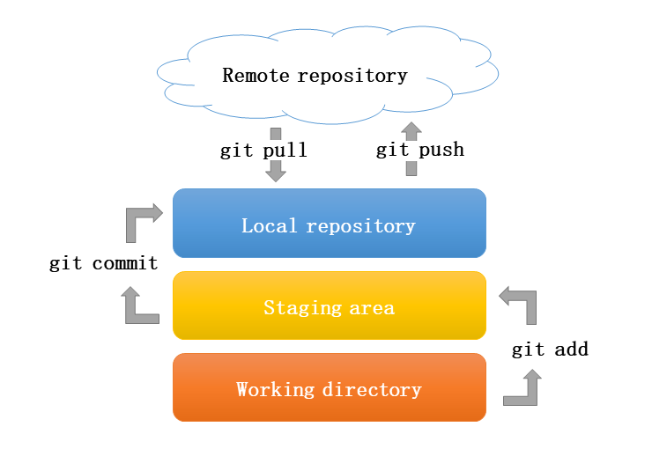
Git and GitHub
What is a Repository?
A repository a.k.a. repo is nothing but a collection of source code.
There are four fundamental elements in the Git Workflow.
Working Directory,
Staging Area,
Local Repository, and
Remote Repository.

Slide 21
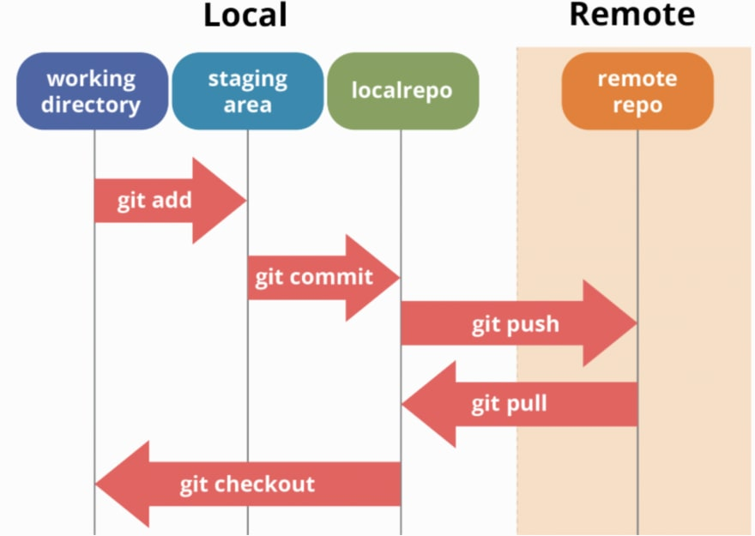
Git and GitHub

Slide 22
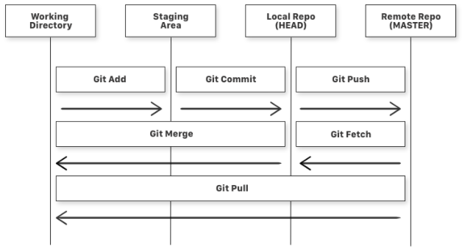
Git and GitHub

Slide 23
Git and GitHub
If you consider a file in your Working Directory, it can be in three possible states -
It can be staged. This means the files with the updated changes are marked to be committed to the local repository but not yet committed.
It can be modified. This means the files with the updated changes are not yet stored in the local repository.
It can be committed. This means that the changes you made to your file are safely stored in the local repository.

Slide 24
Git and GitHub
Some further explanations -
git add . is a command used to add a file that is in the working directory to the staging area.
git commit is a command used to add all files that are staged to the local repository.
git push is a command used to add all committed files in the local repository to the remote repository. So in the remote repository, all files and changes will be visible to anyone with access to the remote repository.

Slide 25
Git and GitHub
git fetch is a command used to get files from the remote repository to the local repository but not into the working directory.
git merge is a command used to get the files from the local repository into the working directory.
git pull is a command used to get files from the remote repository directly into the working directory. It is equivalent to a git fetch and a git merge .
Now that we know what Git is and its basic terminologies, let’s see how we can place a file under git. We’re going to do it the right way and the difficult way. Without any GUI (Graphical User Interface) applications.

Slide 26
Getting Started

Slide 27
GitHub
Go to github.com and make a free account.
Take some time to explore the website.
Create your first repository. Name it anything you like.
Once done, you will see the list of instructions to connect this repository to your code in your computer. Ignore it for now.
Create a folder names gitHello (or anything).
In it, dump some of your codes. Or create a bunch of text files and place them in the folder.

Slide 28
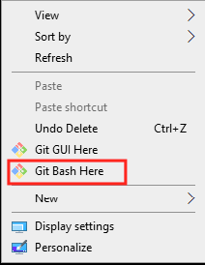
GitHub
Download git in your machine from here.
Install git by following the installer. Go with the default options.
When done, a restart may be required.
Now, you can test installation by right clicking in a folder -
Command type:
git --version

Slide 29
GitHub
Now we need to connect this with your github account.
For that, open git bash and type these commands -
git config --global user.name "YourName"
git config --global user.email "TestEmail@mail.com"
git config --global --list (To check the info you just provided)
Git connect with your local device (pc).

Slide 30
GitHub
Now you would be prompted to enter your credentials every time you push or pull, so we use this command -
git config --global credential.helper "cache --timeout=14400"
This caches your password for the duration of this class (4 hours).
But you can’t store it for ever since the password is stored in plain text which is not secure.
The perfect solution is to set up SSH keys, which we will do later.

Slide 31
Next steps...

Slide 32
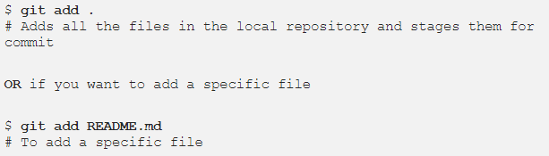
GitHub
Navigate to gitHello folder and right click anywhere. Select git bash here.
Try this - $ git init

Slide 33
GitHub
Let’s see what files are staged -
git status (# Lists all new or modified files to be committed)
Commit changes to your git repo -
git commit -m "First commit"
# The message in the " " is given so that the other users can read the message and see what changes you made
Now files are in the local repository (head)

Slide 34
GitHub
Now each time you make changes in your files and save it, it won’t be automatically updated on GitHub.
All the changes we made in the file are updated in the local repository. Now to update the changes to the master:
Add the origin, i.e., where to put the code -
git remote add origin remote_repository_URL (only needed for the first time)
Then upload it to the origin
$ git push -u origin master # pushes changes to origin

Slide 35
GitHub
Now check out your repository in github website. You will find your code there.
Once you start making changes on your files and you save them, the file won’t match the last version that was committed to git. To see the changes you just made:
git diff # To show the files changes not yet staged

Slide 36
GitHub
You can use the git log command to see the history of commits you made to your files: git log
You can download updated content from the origin
$ git pull origin master # pull changes to origin

Slide 37

GitHub
Each time you make changes that you want to be reflected on GitHub, the following are the most common flow of commands:
Now if we go and see our repo, we can identify whether the commit was successful by looking at the commit message for each file.

Slide 38
Working on other repos

Slide 39
GitHub
Cloning a Git Repo:
Locate to the directory you want to clone the repo. Copy the link of the repository you want and enter the following:
git clone remote_repository_URL
Try it with this repo (or any other repo).
Now you can work on the files you want and commit to changes locally.
If you want to push changes to that repository you either have to be added as a collaborator, which we will discuss later.

Slide 40
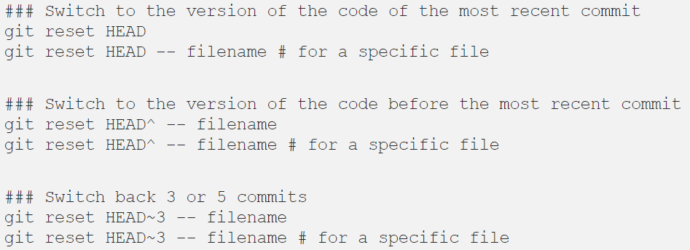
GitHub
Fixing mistakes and backtracking

Slide 41
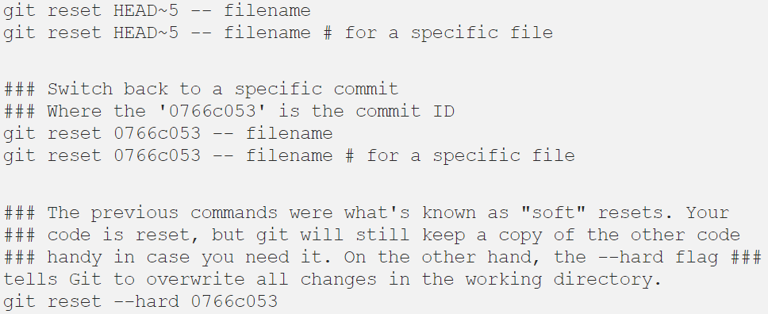
GitHub
Fixing mistakes and backtracking

Slide 42

GitHub
One more thing is the .gitignore file.
.gitignore tells git which files (or patterns) it should ignore.
It's usually used to avoid committing transient files from your working directory that aren't useful to other collaborators, such as compilation products, temporary files IDEs create, etc.
A sample gitignore file may look like this -

Slide 43
GitHub
Ignore all files that -
Have any name with extension .cmake
Have any name with extension .DS_Store
Is exactly name .user
Is exactly named build
To exclude directories, we write -
/folderName/

Slide 44
Classwork

Slide 45
Classwork
Add all you Assignments/projects to github. Make sure to add meaningful readme files to them.
Do that by adding readme.md files to your projects.
In addition, give meaningful names to your repositories too.

Slide 46
Thank you!

